Slide 1


Health Economics Lecture #10
Topic: Value of Information Analysis
Prepared by Jacob Smith, Trent University

Slide 2
Learning Objectives
In this lecture we will discuss:
An Introduction to VoI Analysis.
The Expected Value of Perfect Information.
EVPI Curves
Goal of this Lecture:
Introdouce the concept of value of information analysis.
Understand theoretically the expected value of perfect information

Slide 3
Valuing Information

Slide 4
What is Value of Information Analysis
Value of Information (VoI) Analysis is a set of tools used to inform decision-makers about valuable research programmes.
Its purpose is different from cost effectiveness analysis.
Cost effectiveness analysis is conducted to demonstrate the value for money a treatment or novel drug offers.
Value of Information Analysis conducted to assess the value of reduced model uncertainty.
Value of Information Analysis quantifies the benefit of collecting more evidence (through the conduct of tests).

Slide 5
When Value of Information Analysis
Value of Information Analysis can be used to answer the following questions.
A gene therapy costing $150,000 per patient shows good results but has no long-term durability data. Does it make sense to spend 10 millon dollars in research to acquire more evidence about patient risks.
Several randomized control trials are presented to compete for a limited research budget. VoI analysis can inform decision makers about research priorities.
What is the dollar value of uncertainty which we are willing to pay to reduce and can technologies feasibly reduce that.
While there are several value of information concepts not limited to but including: the expected value of perfect parameter information, expected value of sample information etc. we will only focus on the Expected Value of Perfect Information (EVPI)

Slide 6
The Expected Value of Perfect Information.

Slide 7
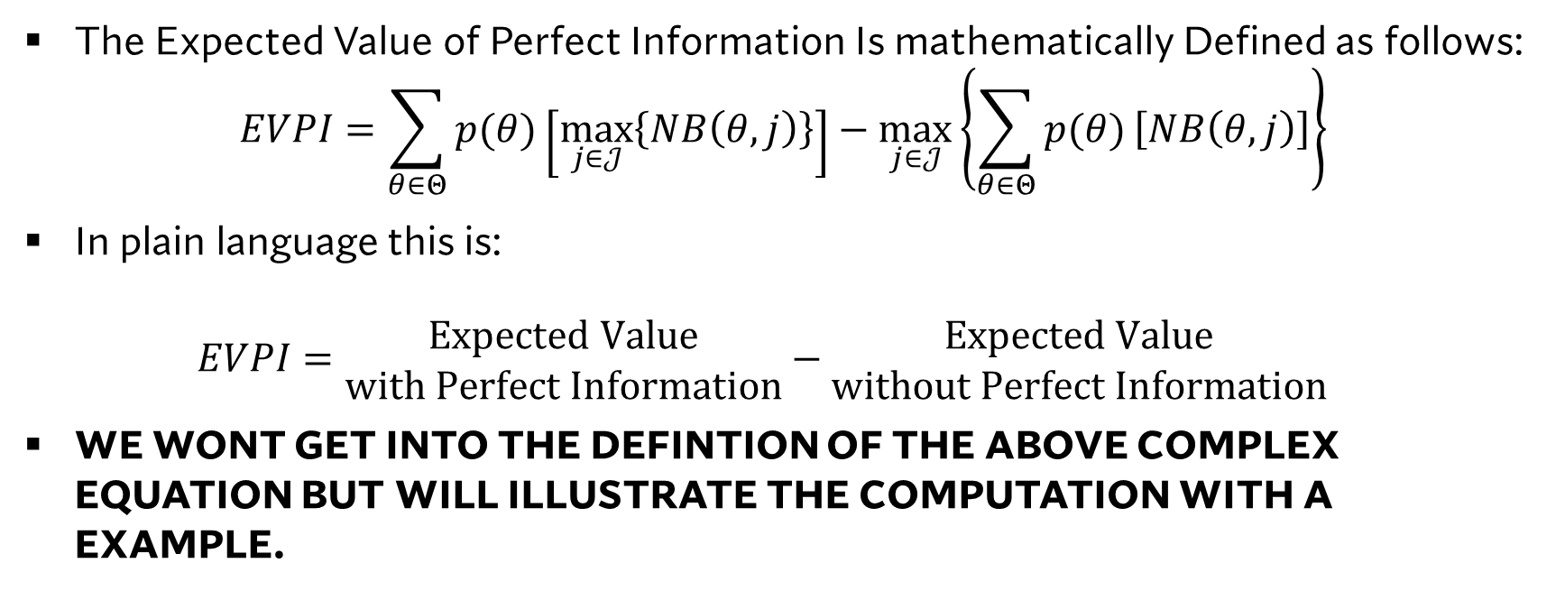
The Expected Value of Perfect Information.
The Expected Value of Perfect Information Is mathematically Defined as follows: $EVPI=\sum_{θ∈Θ}{p(θ)}\left[\max_{j∈𝒥}\left\{NB\left(θ,j\right)\right\}\right]−\max_{j∈𝒥}\left\{\sum_{θ∈Θ}{p(θ)}\left[NB\left(θ,j\right)\right]\right\}$
In plain language this is: $EVPI=\begin{matrix}Expected Value \\ with Perfect Information\end{matrix}−\begin{matrix}Expected Value \\ without Perfect Information\end{matrix}$
WE WONT GET INTO THE DEFINTION OF THE ABOVE COMPLEX EQUATION BUT WILL ILLUSTRATE THE COMPUTATION WITH A EXAMPLE.

Slide 8
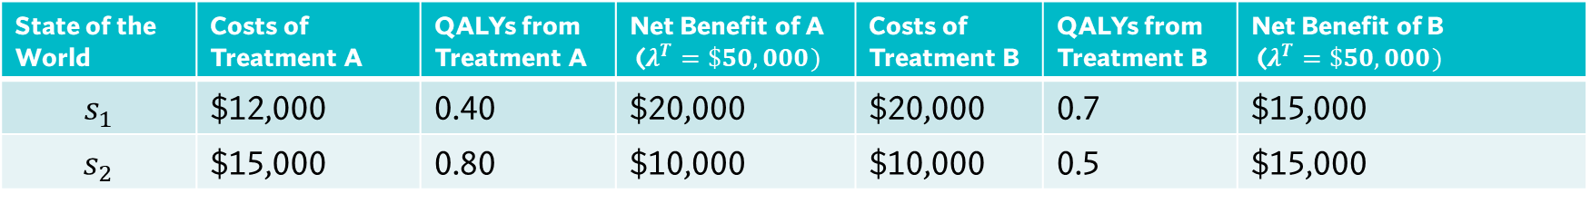
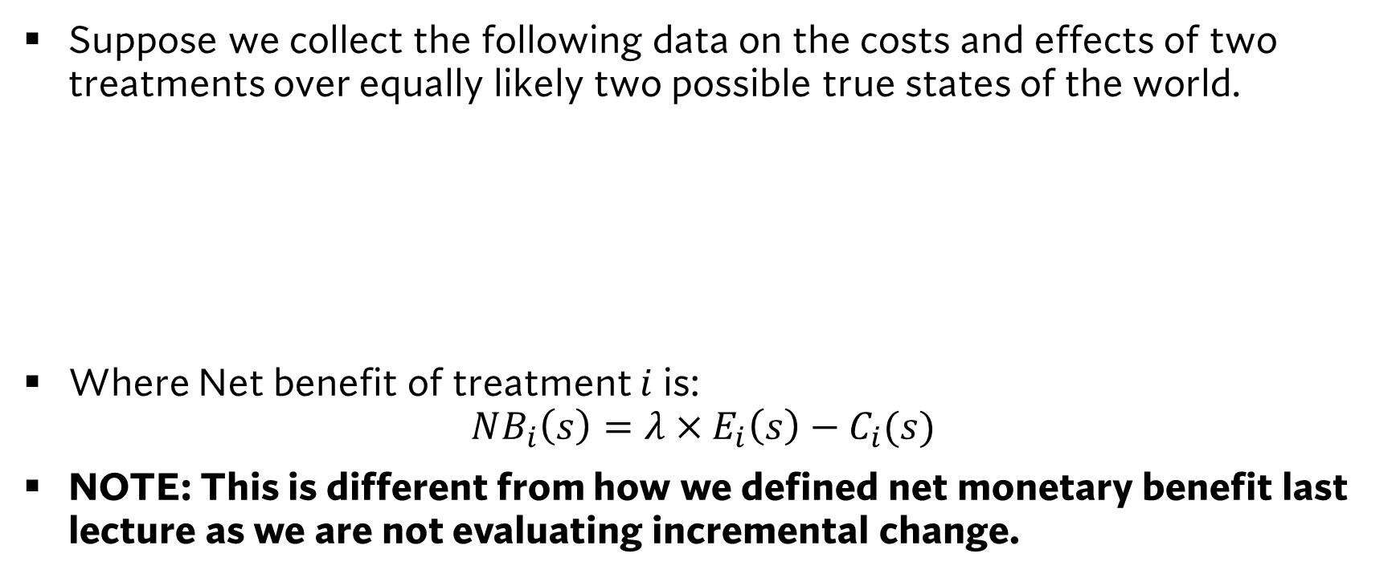
An Example from a Data Table
Suppose we collect the following data on the costs and effects of two treatments over equally likely two possible true states of the world.
Where Net benefit of treatment $i$ is: $NB_{i}\left(s\right)=λ×E_{i}\left(s\right)−C_{i}(s)$
NOTE: This is different from how we defined net monetary benefit last lecture as we are not evaluating incremental change.
State of the World | Costs of Treatment A | QALYs from Treatment A | Net Benefit of A ($λ^{T}=\$50,000)$ | Costs of Treatment B | QALYs from Treatment B | Net Benefit of B ($λ^{T}=\$50,000)$
$$s_{1}$$ | $12,000 | 0.40 | $20,000 | $20,000 | 0.7 | $15,000
$$s_{2}$$ | $15,000 | 0.80 | $10,000 | $10,000 | 0.5 | $15,000

Slide 9
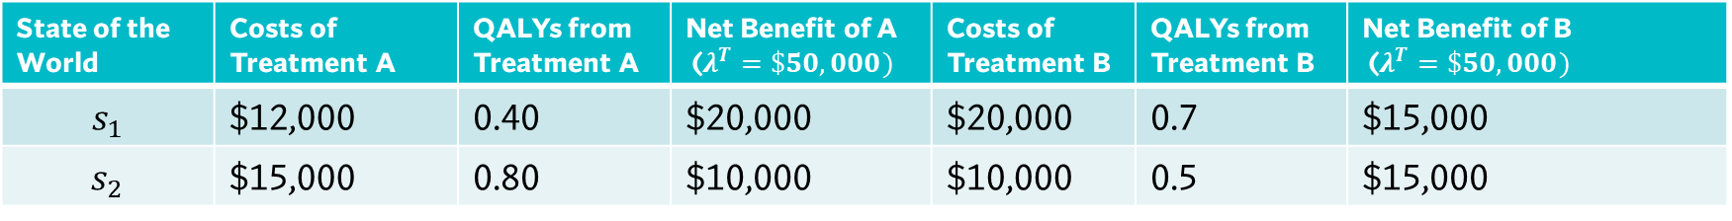
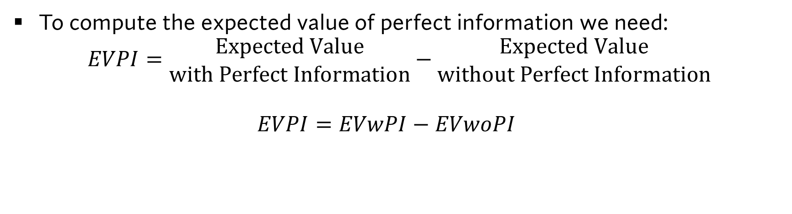
An Example from a Data Table
State of the World | Costs of Treatment A | QALYs from Treatment A | Net Benefit of A ($λ^{T}=\$50,000)$ | Costs of Treatment B | QALYs from Treatment B | Net Benefit of B ($λ^{T}=\$50,000)$
$$s_{1}$$ | $12,000 | 0.40 | $20,000 | $20,000 | 0.7 | $15,000
$$s_{2}$$ | $15,000 | 0.80 | $10,000 | $10,000 | 0.5 | $15,000
To compute the expected value of perfect information we need: $EVPI=\begin{matrix}Expected Value \\ with Perfect Information\end{matrix}−\begin{matrix}Expected Value \\ without Perfect Information\end{matrix}$ $EVPI=EVwPI−EVwoPI$

Slide 10
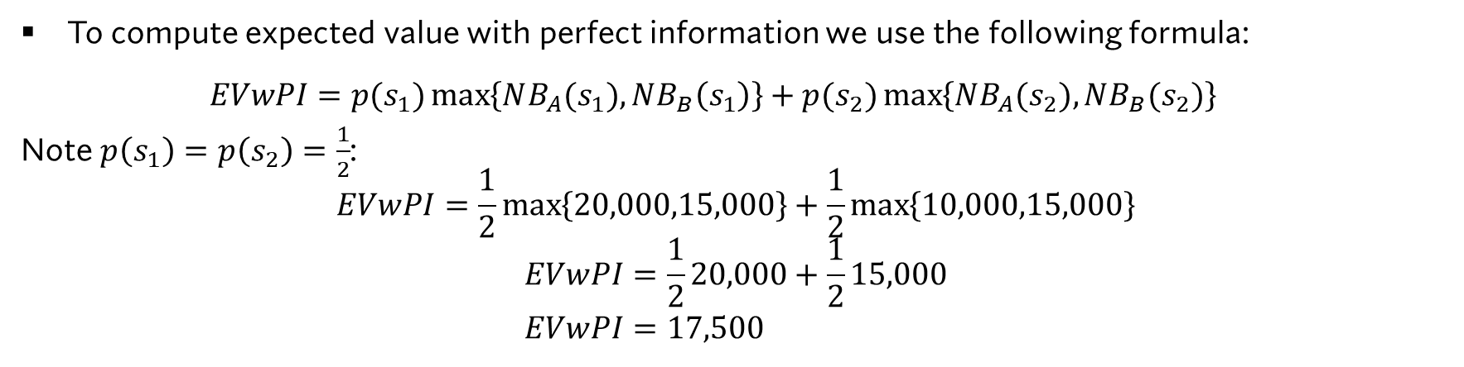
An Example from a Data Table
State of the World | Costs of Treatment A | QALYs from Treatment A | Net Benefit of A ($λ^{T}=\$50,000)$ | Costs of Treatment B | QALYs from Treatment B | Net Benefit of B ($λ^{T}=\$50,000)$
$$s_{1}$$ | $12,000 | 0.40 | $20,000 | $20,000 | 0.7 | $15,000
$$s_{2}$$ | $15,000 | 0.80 | $10,000 | $10,000 | 0.5 | $15,000
To compute expected value with perfect information we use the following formula: $EVwPI=p(s_{1})\max\left\{NB_{A}(s_{1}),NB_{B}\left(s_{1}\right)\right\}+p(s_{2})\max\left\{NB_{A}(s_{2}),NB_{B}(s_{2})\right\}$
Note $p\left(s_{1}\right)=p\left(s_{2}\right)=\frac{1}{2}$: $$EVwPI=\frac{1}{2}\max\left\{20,000,15,000\right\}+\frac{1}{2}\max\left\{10,000,15,000\right\}$$
$$EVwPI=\frac{1}{2}20,000+\frac{1}{2}15,000 \\ EVwPI=17,500$$

Slide 11
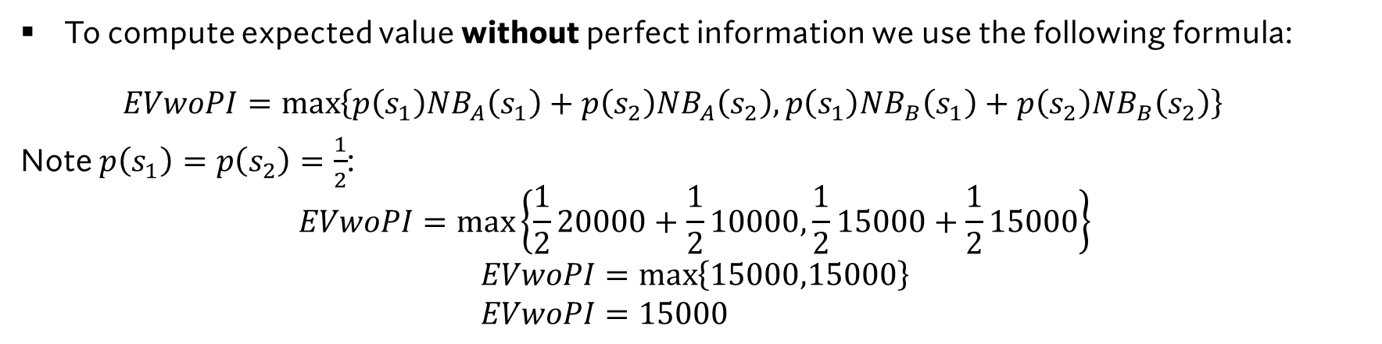
An Example from a Data Table
State of the World | Costs of Treatment A | QALYs from Treatment A | Net Benefit of A ($λ^{T}=\$50,000)$ | Costs of Treatment B | QALYs from Treatment B | Net Benefit of B ($λ^{T}=\$50,000)$
$$s_{1}$$ | $12,000 | 0.40 | $20,000 | $20,000 | 0.7 | $15,000
$$s_{2}$$ | $15,000 | 0.80 | $10,000 | $10,000 | 0.5 | $15,000
To compute expected value without perfect information we use the following formula: $EVwoPI=\max\left\{p\left(s_{1}\right)NB_{A}\left(s_{1}\right)+p\left(s_{2}\right)NB_{A}\left(s_{2}\right),p\left(s_{1}\right)NB_{B}\left(s_{1}\right)+p\left(s_{2}\right)NB_{B}\left(s_{2}\right)\right\}$
Note $p\left(s_{1}\right)=p\left(s_{2}\right)=\frac{1}{2}$: $$EVwoPI=\max\left\{\frac{1}{2}20000+\frac{1}{2}10000,\frac{1}{2}15000+\frac{1}{2}15000\right\}$$
$$EVwoPI=\max\left\{15000,15000\right\} \\ EVwoPI=15000$$

Slide 12
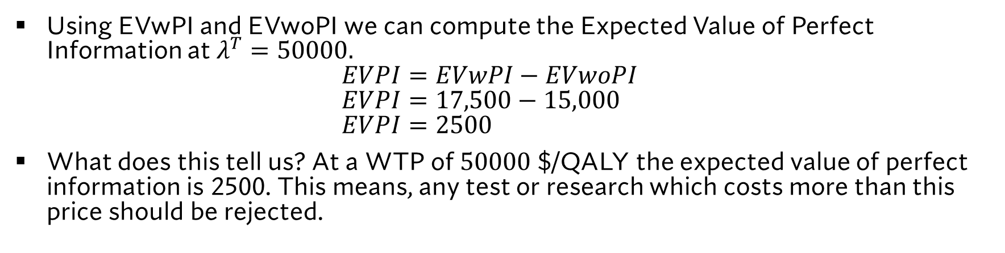
An Example from a Data Table
State of the World | Costs of Treatment A | QALYs from Treatment A | Net Benefit of A ($λ^{T}=\$50,000)$ | Costs of Treatment B | QALYs from Treatment B | Net Benefit of B ($λ^{T}=\$50,000)$
$$s_{1}$$ | $12,000 | 0.40 | $20,000 | $20,000 | 0.7 | $15,000
$$s_{2}$$ | $15,000 | 0.80 | $10,000 | $10,000 | 0.5 | $15,000
Using EVwPI and EVwoPI we can compute the Expected Value of Perfect Information at $λ^{T}=50000.$ $EVPI=EVwPI−EVwoPI$ $EVPI=17,500−15,000$ $EVPI=2500$
What does this tell us? At a WTP of $50000$ $/QALY the expected value of perfect information is 2500. This means, any test or research which costs more than this price should be rejected.

Slide 13
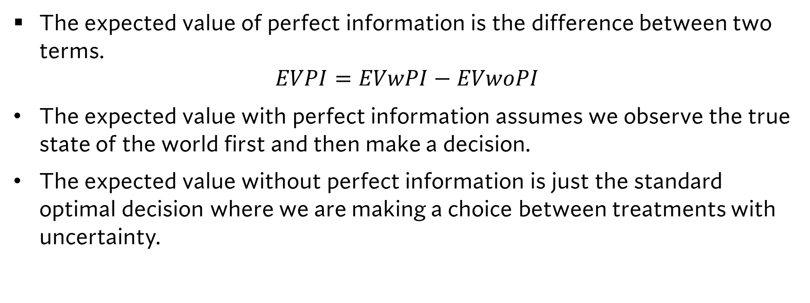
What EVPI is really
The expected value of perfect information is the difference between two terms.
$$EVPI=EVwPI−EVwoPI$$
The expected value with perfect information assumes we observe the true state of the world first and then make a decision.
The expected value without perfect information is just the standard optimal decision where we are making a choice between treatments with uncertainty.

Slide 14
EVPI CURVES

Slide 15
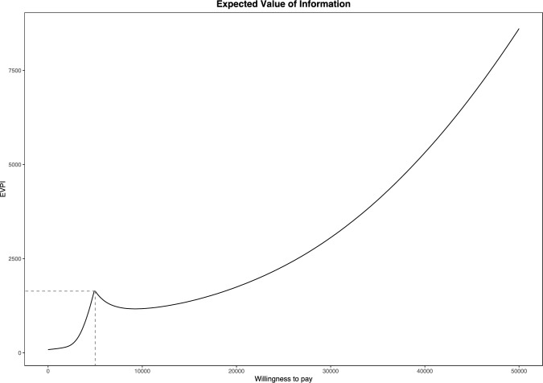
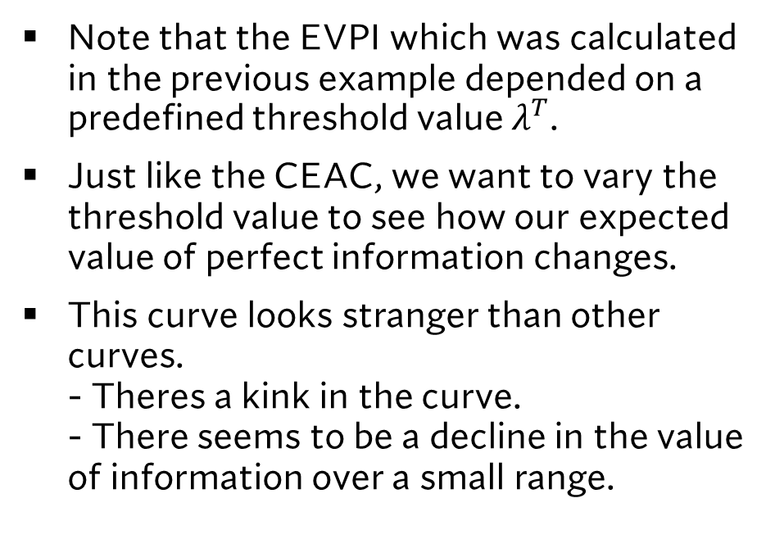
Graphically Representing EVPI
Note that the EVPI which was calculated in the previous example depended on a predefined threshold value $λ^{T}$.
Just like the CEAC, we want to vary the threshold value to see how our expected value of perfect information changes.
This curve looks stranger than other curves. - Theres a kink in the curve. - There seems to be a decline in the value of information over a small range.
Source: Nurchis, M. C., Radio, F. C., Salmasi, L., Heidar Alizadeh, A., Raspolini, G. M., Altamura, G., ... & Damiani, G. (2024). Bayesian cost-effectiveness analysis of Whole genome sequencing versus Whole exome sequencing in a pediatric population with suspected genetic disorders. The European Journal of Health Economics, 25(6), 999-1011.

Slide 16
Graphically Representing EVPI
To address each of these issues: 1. The kink in the curve occurs when there is a change in optimal treatment strategy (from treatment B to treatment A) in the EVwoPI part of the EVPI calculation. 2. The curvature in the EVPI curve is due to combining the EVPI results with our probability of cost effectiveness.
Source: Nurchis, M. C., Radio, F. C., Salmasi, L., Heidar Alizadeh, A., Raspolini, G. M., Altamura, G., ... & Damiani, G. (2024). Bayesian cost-effectiveness analysis of Whole genome sequencing versus Whole exome sequencing in a pediatric population with suspected genetic disorders. The European Journal of Health Economics, 25(6), 999-1011.

Slide 17
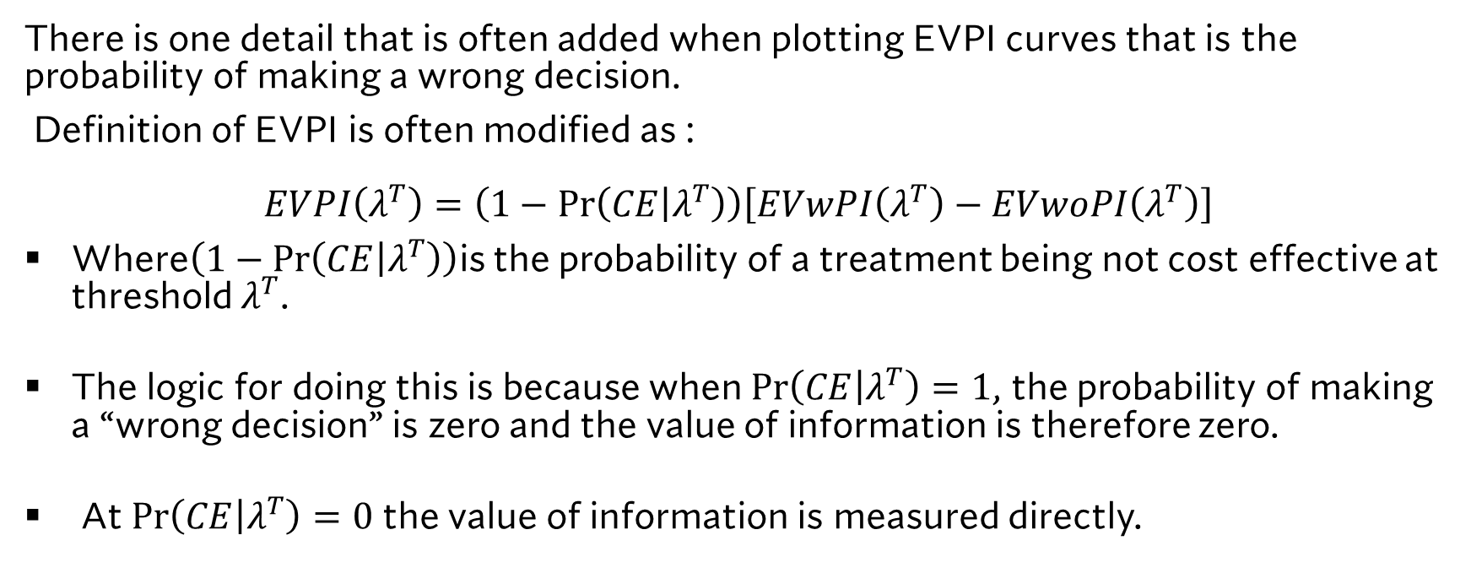
Combining EVPI and the Probability of cost effectiveness
There is one detail that is often added when plotting EVPI curves that is the probability of making a wrong decision.
Definition of EVPI is often modified as : $$EVPI\left(λ^{T}\right)=\left(1−\operatorname{Pr}\left(CE | λ^{T}\right)\right)\left[EVwPI\left(λ^{T}\right)−EVwoPI\left(λ^{T}\right)\right]$$
Where$\left(1−\operatorname{Pr}\left(CE | λ^{T}\right)\right)$is the probability of a treatment being not cost effective at threshold $λ^{T}$.
The logic for doing this is because when $\operatorname{Pr}\left(CE | λ^{T}\right)=1$, the probability of making a “wrong decision” is zero and the value of information is therefore zero.
At $\operatorname{Pr}\left(CE | λ^{T}\right)=0$ the value of information is measured directly.

Slide 18
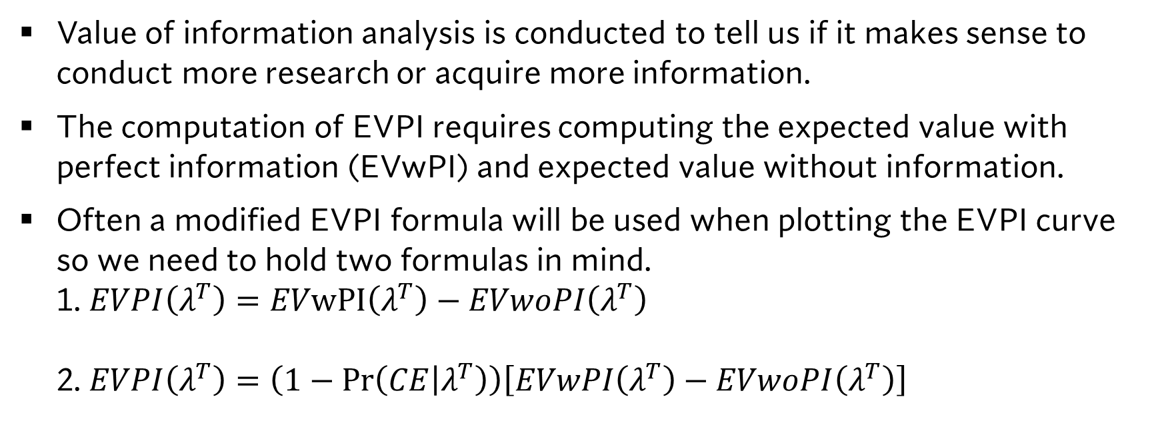
Some concluding remarks on EVPI
Value of information analysis is conducted to tell us if it makes sense to conduct more research or acquire more information.
The computation of EVPI requires computing the expected value with perfect information (EVwPI) and expected value without information.
Often a modified EVPI formula will be used when plotting the EVPI curve so we need to hold two formulas in mind. 1. $EVPI\left(λ^{T}\right)=EVwPI\left(λ^{T}\right)−EVwoPI\left(λ^{T}\right)$ 2. $EVPI\left(λ^{T}\right)=\left(1−\operatorname{Pr}\left(CE | λ^{T}\right)\right)\left[EVwPI\left(λ^{T}\right)−EVwoPI\left(λ^{T}\right)\right]$

Slide 19
Learning Objectives
In this lecture we will discuss:
An Introduction to VoI Analysis.
The Expected Value of Perfect Information.
EVPI Curves
Goal of this Lecture:
Introdouce the concept of value of information analysis.
Understand theoretically the expected value of perfect information

